Slide 1

There’s No Place Like Home
Design and Implementation
of a Segmented,
Privacy-Centric Homelab
Using Open-Source Platforms
Wolfgang Helnwein
Notes:
Hi, my name is Wolfgang Helnwein. This presentation covers my final project, There’s No Place Like Home, which focuses on designing a segmented, privacy‑centric homelab using open‑source platforms.

Slide 2
First, A Definition: Homelab
English
Etymology
From home +‎ lab.
Noun
homelab (plural homelabs)
(computing) A server set up in one's home for the purpose of testing various configurations of hardware, operating systems, etc.
https://en.wiktionary.org/wiki/homelab
Notes:
Before I start – just a quick definition:
This project is informed by the “homelabbing” movement, which involves setting up a personal environment for experimenting with information technologies to develop practical skills in networking, systems administration, and familiarity with enterprise‑level tools (r/homelab Community Members, 2025).

Slide 3
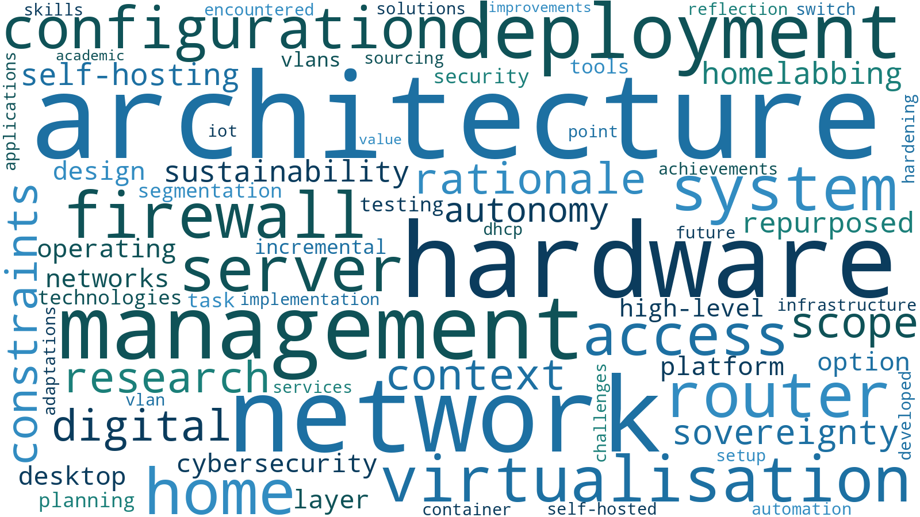
Project Overview
Notes:
At a very high level, this project is built around two core components.
OPNsense acts as the central router and firewall. It’s responsible for routing traffic and enforcing separation between different parts of the network.
Proxmox provides the virtualisation layer. That’s where servers and self‑hosted services actually run.
I’ll come back to how each of these is set up later — for now, what matters is that they let me separate devices by trust and still keep the network usable.

Slide 4
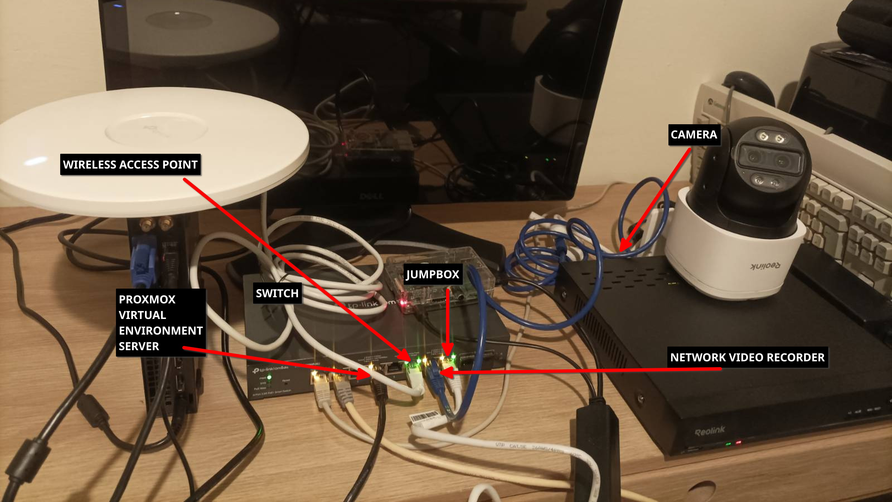
System In Operation (Live Demo)
Notes:
Before getting into the design and implementation details, I’ll briefly give you an idea of what the homelab is like in practice.
Because this is a live production network, I’m using screenshots and short video clips rather than interacting with the system live, to avoid exposing sensitive configuration details.
This is however a real, working setup, and it’s the same network I’m using right now to give this presentation.

Slide 5
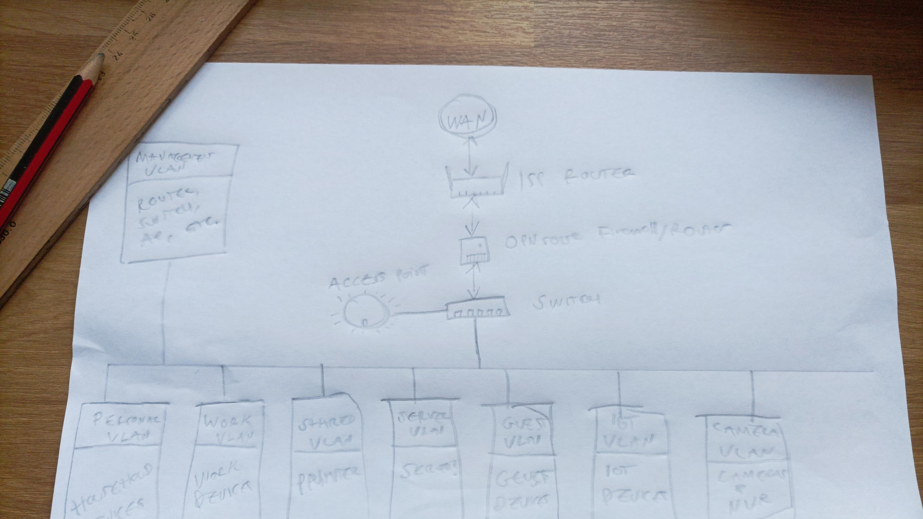
System Architecture & Design
Notes:
I’ll now explain how the system was designed and structured to support the features and security configuration you’ve just seen.

Slide 6
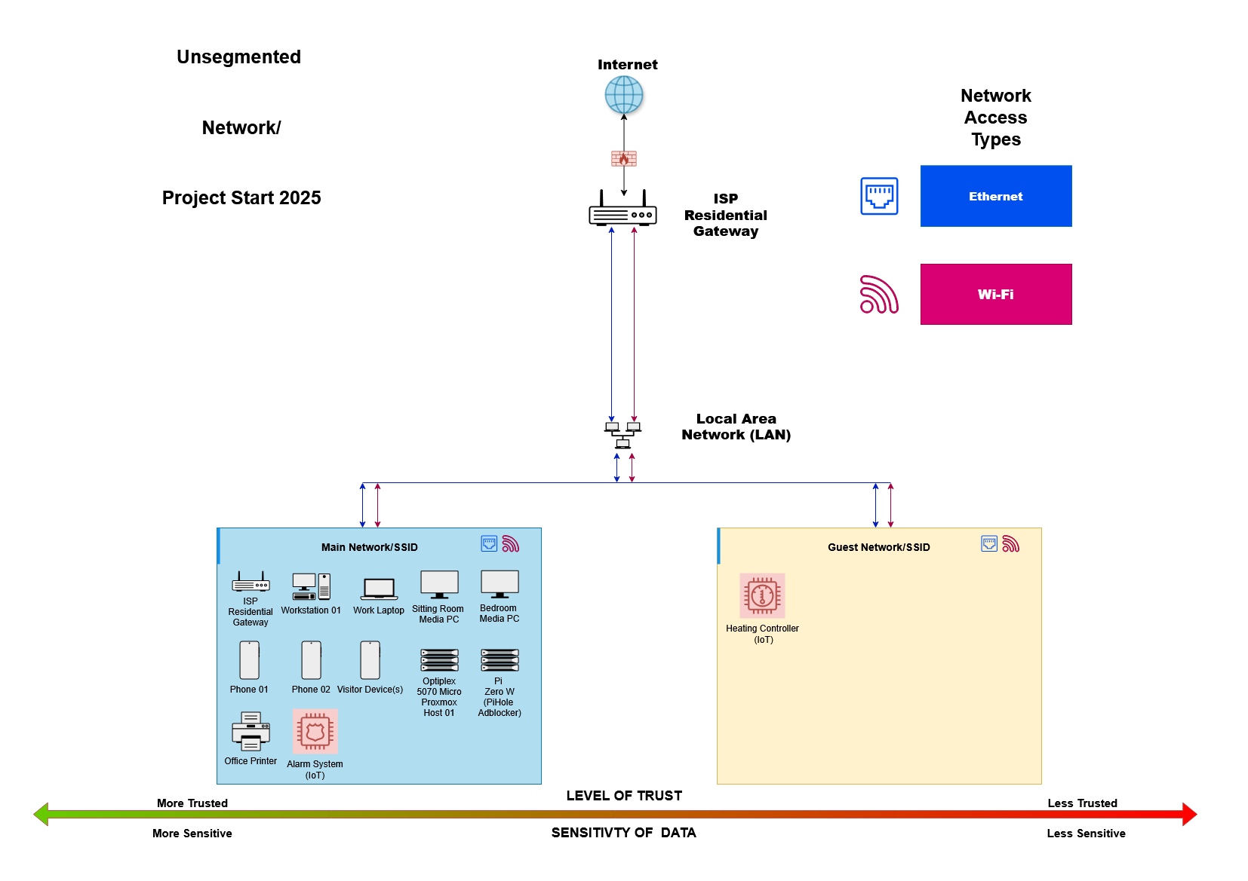
Starting Point: A Flat Network
Notes:
To give context for the project, the original network was a standard ISP‑provided home setup.
While it included a main and guest network intended to isolate less trustworthy IoT devices, this separation was poorly enforced, with IoT, work, server, and personal devices ultimately mixed on the main network.

Slide 7
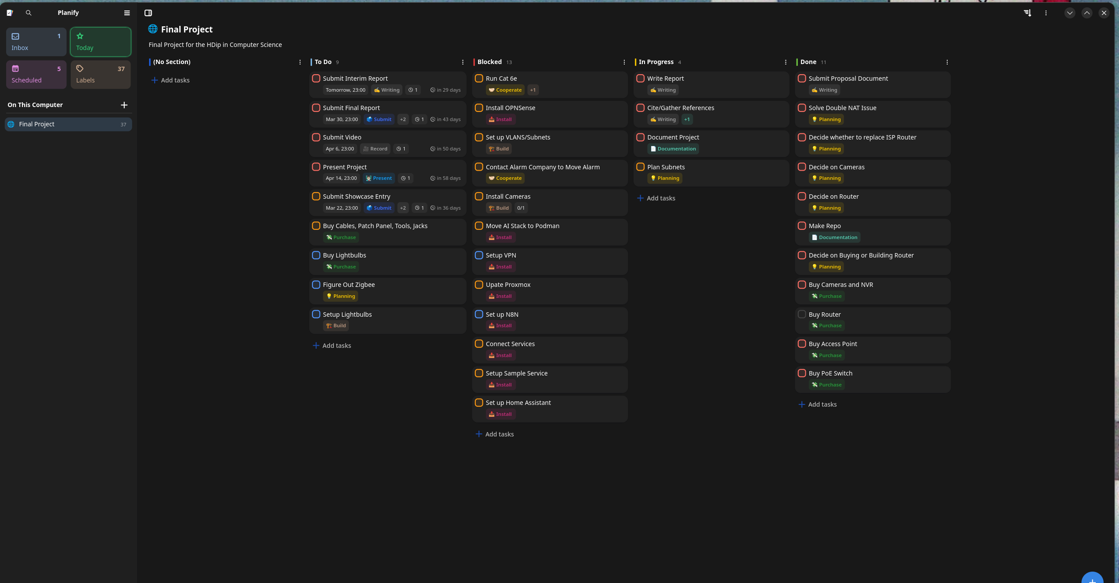
Methodology: Kanban
Notes:
Because this project was very hardware‑centric and didn’t follow a traditional software development lifecycle, I adopted a Kanban approach.
Kanban worked well for managing tasks with external dependencies, such as hardware procurement and staged setup, and it allowed me to easily reprioritise work when something became blocked.
I used a simple Kanban board in Planify to track tasks as the project evolved.

Slide 8
Design Goals & Considerations
Security without breaking usability
Clear separation of devices based on trust
Local services over cloud dependency
Making use of second-hand hardware where possible
Notes:
With the issues with the original network identified, I defined a small set of goals:
Security without breaking usability.
Clear separation of devices based on trust.
Preference for local services over the cloud.
Reuse of secondhand hardware where possible.

Slide 9
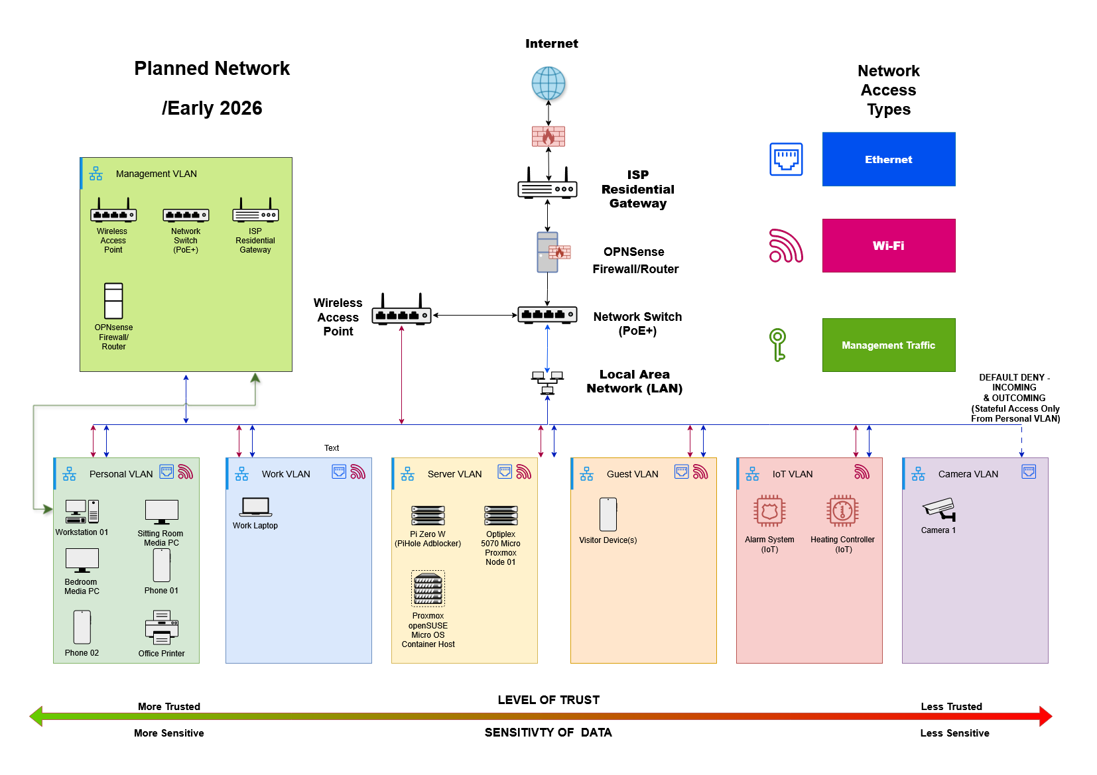
Initial Design
Notes:
The initial design planned for seven VLANs with clearly defined roles:
Management – network infrastructure such as the router, switch, and access point.
Personal – household devices such as desktops and phones.
Work – work‑related devices.
Server – the Proxmox virtualisation environment and hosted services.
Guest – visitors to the home.
IoT – IoT devices.
Camera – the network video recorder and cameras.
Firewall rules were used to enforce isolation between these networks.
Access to the management VLAN was intended to be carried out physically via a tagged switch port.

Slide 10
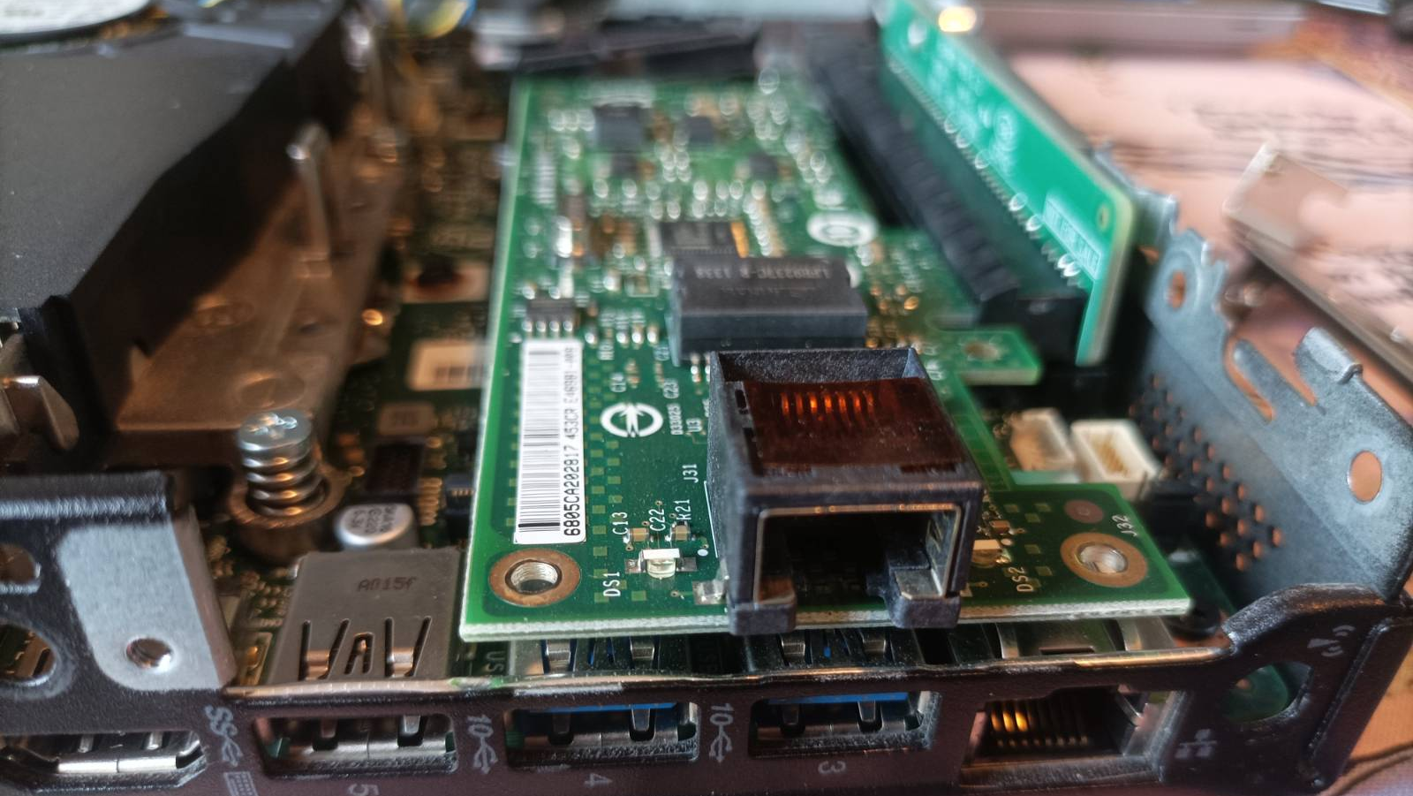
Implementation
Notes:
The next part focuses on implementation.
The system was built iteratively, with infrastructure and services added gradually and hardening applied between stages.

Slide 11
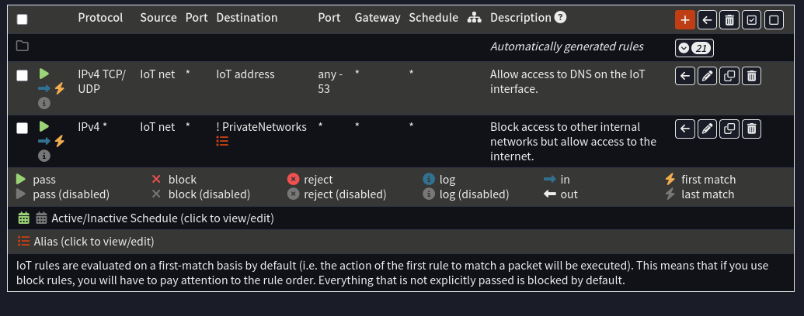
Network Segmentation in Practice
Notes:
To implement the trust‑based design, devices were placed into VLANs based on their role.
For example, IoT devices were placed in a dedicated IoT VLAN with access to basic services such as DNS and the internet, but not to other private networks.
This formed the baseline level of hardening across the network.
The camera VLAN applied stricter rules, with no firewall rules defined, relying on OPNsense’s default deny behaviour to prevent any outbound or lateral access.

Slide 12
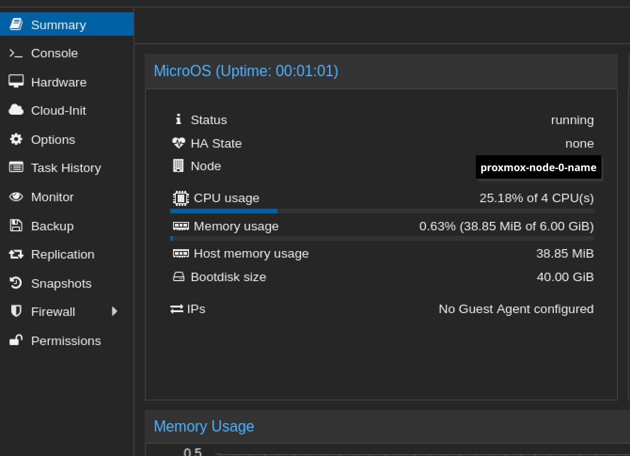
Virtualisation Environment
Notes:
Open-source applications like Mealie are hosted on a virtualization stack, with Proxmox as its foundation.
Instead of running the containers directly on Proxmox, I followed best practice and introduced a layer of isolation, having them run on a Virtual Machine with openSUSE MicroOS as a dedicated container host.
On this VM, I used Podman to deploy the required services.
Hostnames and HTTPS certificates are handled through a Traefik reverse proxy running on a separate container.

Slide 13
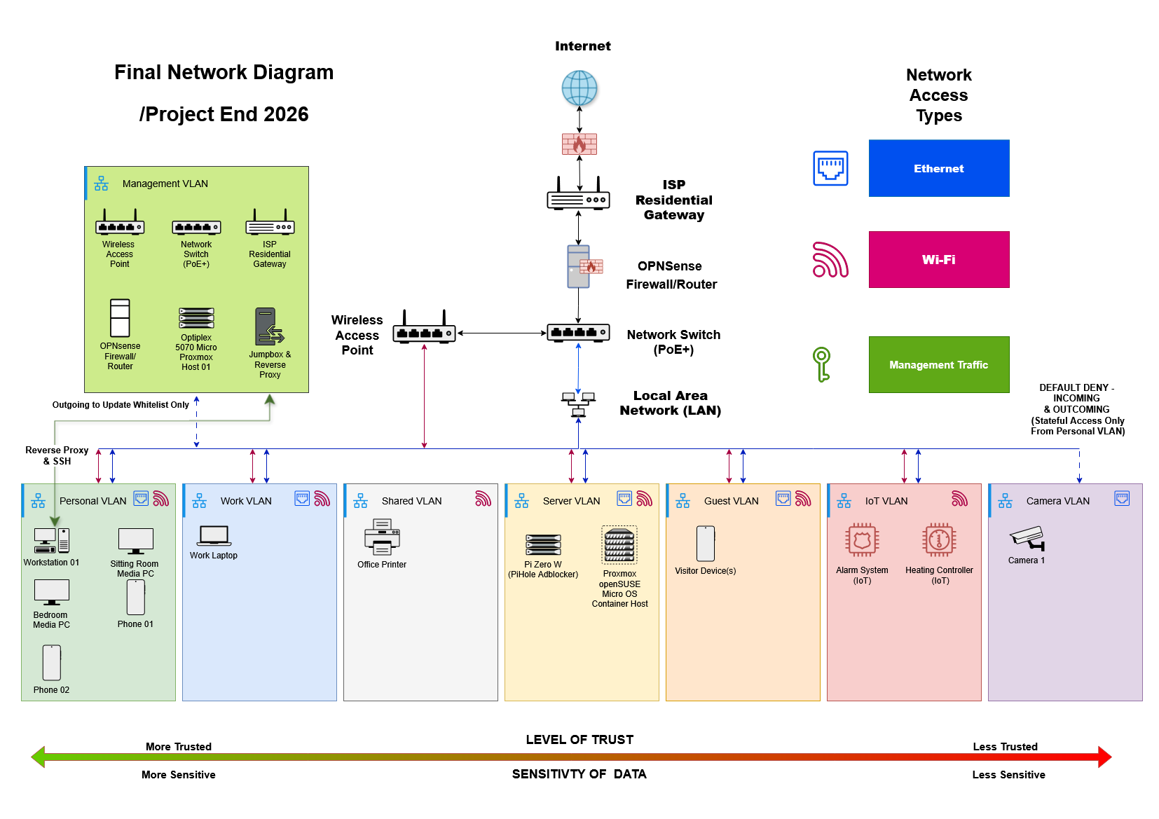
High Level Network Architecture
Notes:
This diagram shows the final high‑level structure of the network after the design was implemented and refined.
The network remains organised around trust, with devices grouped into VLANs and all traffic flowing through the central router and firewall.
There were a small number of deliberate departures from the original design:
– Management access is now carried out over SSH via the jumpbox, providing a more secure and controllable entry point.
– The Proxmox server itself was moved into the Management VLAN, while its VMs and containers remain in the Server VLAN.
– Printers and other shared devices were placed in a new eighth VLAN, ‘Shared’, to improve isolation.
These refinements improved isolation and manageability while preserving the original trust‑based design.

Slide 14
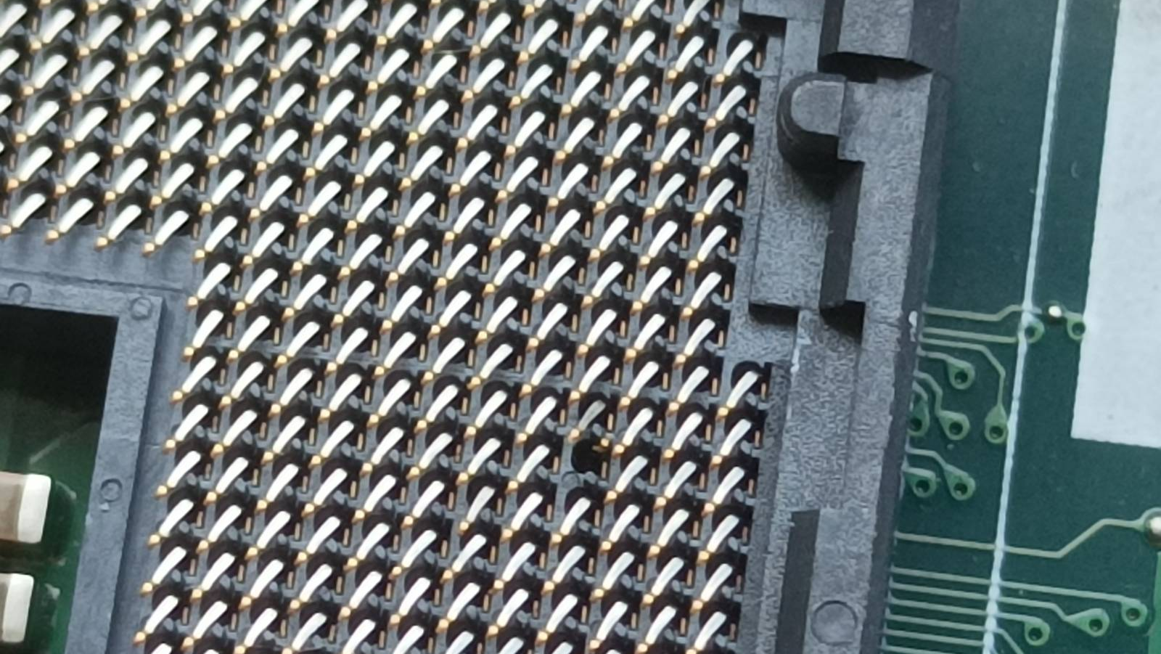
Challenges Encountered & Solutions
Notes:
During the project I encountered several challenges, particularly around hardware:
The router PC arrived in poor condition, with cooler paste having spilled into the CPU socket. While cleaning it, I accidentally bent some pins. Though I tried to fix them under magnification, I realised some had actually snapped off.
Under time pressure, I sourced a replacement PC of the same model, and later repaired the original by sourcing a replacement motherboard.
This led to the second issue: I accidentally installed OPNsense on the wrong PC, which had an incompatible network card. I spent several hours troubleshooting this, until I realised the mixup that had occurred.
As the network became more segmented and locked down, I also locked myself out multiple times. Since all devices were in the same room though, I could recover from these events quickly.

Slide 15
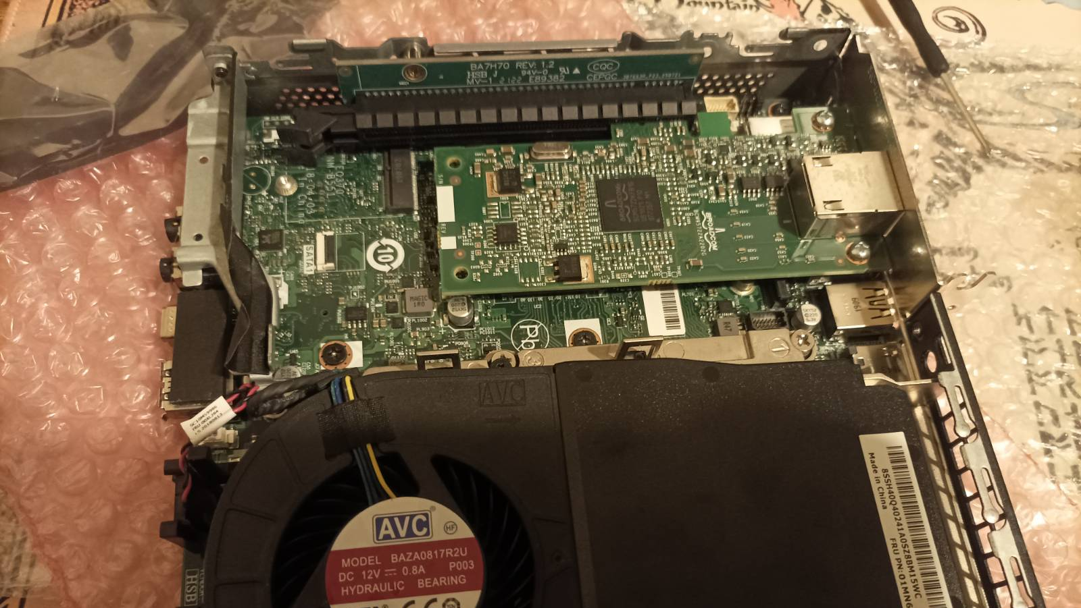
Reflection and Learning
Notes:
Although there is nothing particularly novel about this setup, I approached this project primarily as a learning exercise.
I re-architected a flat home network into a segmented and hardened environment, while still supporting everyday home use.
Working through this process improved my understanding of trust-based segmentation, stateful firewalls and layered security controls, as well as the importance of iterative testing.
Overall, the system provides both a more secure baseline for day-to-day use and a homelab for further experimentation beyond the project’s end.

Slide 16
Future Plans
Lay ethernet between rooms and floors.
Move devices to final locations.
Introduce a small number of additional local services.
Notes:
Beyond the scope of the project, there a few clear next steps.
The most immediate one is completing the physical infrastructure by laying ethernet runs and moving devices to their final locations around the house.
Once that is in place, I may deploy some additional devices such as a Network Accessible Storage, or more services, like Home Assistant, so I can delve into home automation.

Slide 17
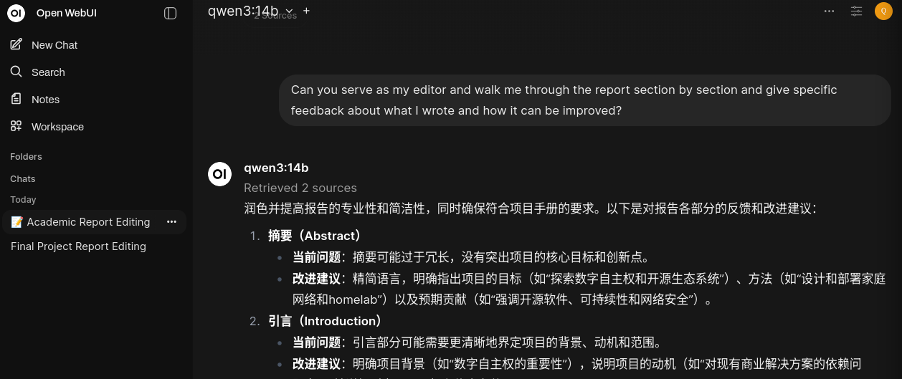
Use of AI
AI tools like Copilot were used as editorial and research support.
AI was used to cut wordcounts and refine the structure of the report and slide deck.
No AI tools were used to design, configure or implement the system.
Notes:
I used AI tools in a limited support role, mainly Copilot for editing, reducing word count, and occasionally clarifying ideas during research.
I experimented with AI for hardware comparison and troubleshooting, including Gemini, but found results unreliable due to hallucinated specifications and rapid loss of context.
I also experimented with smaller local models like Qwen 3, but I found they had stability issues – such as switching to Chinese without warning.
No AI tools were used to implement the network itself and all technical work was my own.

Slide 18

Questions?
Notes:
If you have any questions, I’d be happy to take them now.

